Slide 1
Hyperboloid embeddings and Hypersphere similarity metrics for Sentence-BERT
Garvit Goyal, Gunjan Gupta, Tusheet Goli
Notes:
Tusheet

Slide 2
Sentence-BERT
(SBERT)
SBERT is a modified BERT network
Better for deriving semantically meaningful sentence embeddings
State-of-art sentence embedding model that is computationally efficient to get sentence embeddings
Uses siamese and triplet network structures
Uses distance as similarity metrics and contrastive loss
Notes:
Gunjan
proven to achieve better embeddings for embedding than the one that we get by averaging word embeddings BERT
contrastive loss trains the model to decrease distance between similar pairs and increase distance between dissimilar pairs

Slide 3
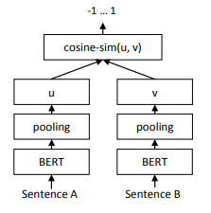
Sentence-BERT
(SBERT)
Architecture
Notes:
Gunjan
Sentence pairs are supplied to the model to generate embedding u, v which are then trained on contrastive loss

Slide 4
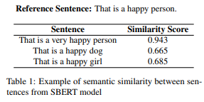
Our Goal
Analyze and understand SBERT
Aim to improve SBERT
Changing the pooling layer to go from BERT word embeddings to sentence embeddings
Exploring other similarity metrics that might be more suited for the semantic similarity task
Notes:
Tusheet

Slide 5
Datasets

Slide 6
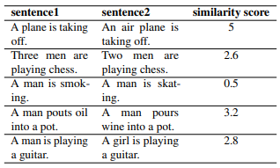
STSb
(Semantic Textual Similarity Benchmark)
A selection of English datasets that have been primarily used as a benchmark dataset for SemEval between 2012 and 2017
Includes text from image captions, news headlines, and user forum
Consists of 8628 sentence pairs from multiple genres
Divided into a train, dev, and test splits
Notes:
Tusheet
We use the STSb (Semantic Textual Similarity Benchmark) dataset for training and evaluation for the following two methods - (1) changing the architecture by introducing CNN layer after the BERT word embeddings, (2) changing the loss function using hyperboloid embeddings.

Slide 7
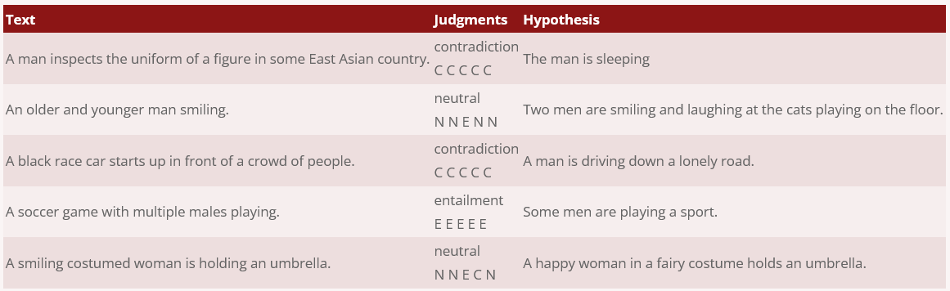
SNLI
(Stanford Natural Language Inference)
Contains 570,000 sentence pairs labeled as entailment, neutral, or contradiction
Binary labeled dataset of sentence pairs
Used for testing our uniformity and alignment as the similarity metrics in our loss function
Notes:
Tusheet
For the method of using uniformity and alignment as similarity metrics in our loss function, we need binary labeled dataset of sentence pairs.

Slide 8
Model

Slide 9
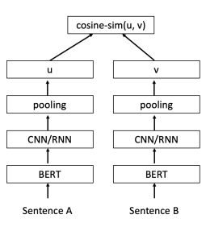
Proposed Architecture
Notes:
Garvit

Slide 10
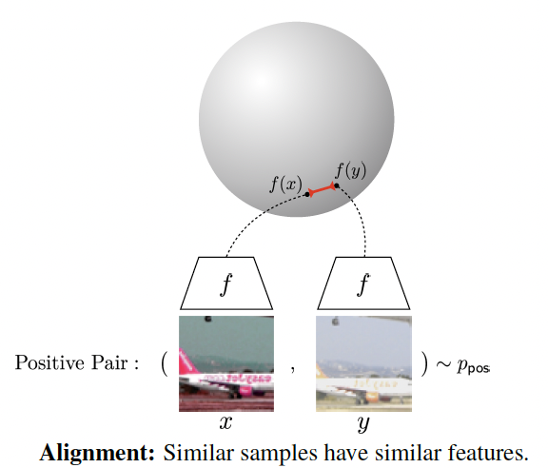
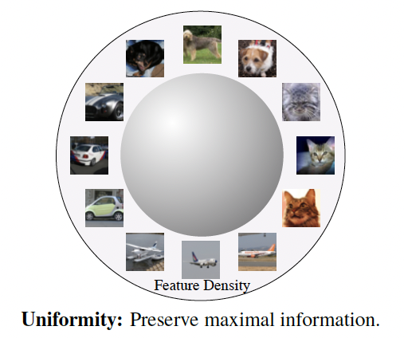
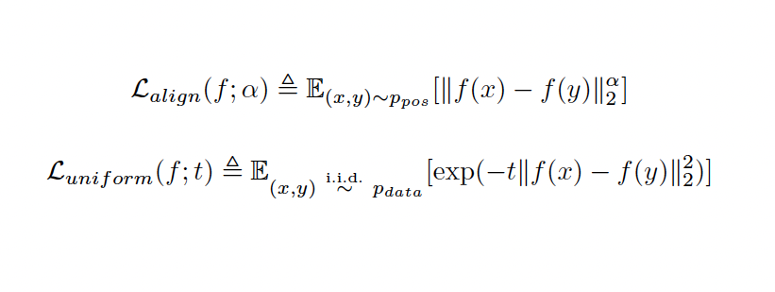
Hyperspherical loss functions
Source: Wang and Isola (2020)
Notes:
Garvit

Slide 11
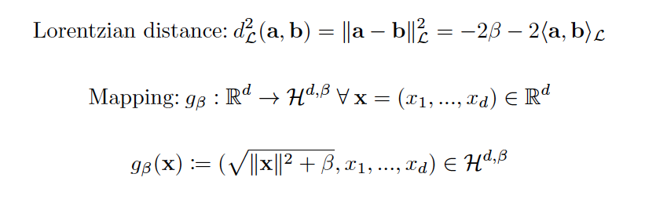
Hyperboloid Embeddings
Notes:
Garvit

Slide 12
Implementation Details

Slide 13
Implementation Details
Baseline: bert-base-uncased followed by mean pooling
Optimizer: SGD with lr = 0.001 and momentum = 0.9
The NLI versions were trained on NLI for one epoch, and the STS versions were trained on the STS dataset for 10 epochs.
Both types of models were validated every 10% of iterations on dev split of STS benchmark, and tested on test split of STS benchmark
Notes:
Garvit
bert-base is intended for tasks involving sentence embeddings from word embeddings.

Slide 14
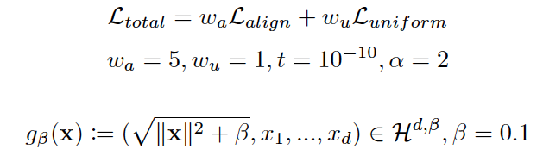
Implementation Details
Notes:
Garvit

Slide 15
Results
Model | Distance Function | Loss Function | STS Benchmark Test Performance (Spearman coefficient)
BERT-STSB-Baseline | Cosine | Contrastive | 0.839
BERT-STSB-CNN + Mean Pooling | Cosine | Contrastive | 0.840
BERT-STSB-CNN + Max Pooling | Cosine | Contrastive | 0.824
BERT-STSB-hyperboloid | Lorentz | Contrastive | 0.591
BERT-NLI-hypersphere | Euclidean | Uniformity - Alignment | 0.547
BERT-NLI-hypersphere + hyperboloid | Lorentz | Uniformity - Alignment | 0.536
Notes:
Thus, the preliminary experiments indicate that inclusion of CNN before pooling does not lead to a significant improvement in SBERT’s performance, and thus we won’t be modifying the pooling layer in this work.
We can also see that just using CNN (BERT-STSB-CNN + Max Pooling) to get sentence embedding by convolving the word embeddings yields inferior results.This might be because the mean pooling in the model makes use of attention mask which is better able to capture the contribution of individual words to the overall semantics of the sentence rather than just the convolutional layer.
We used Lorentz distance as it was shown to capture more information in other tasks. However, it didn’t work in this context while averaging the word embeddings and we get worse performance than baseline. Future works could try to evaluate better distance functions for this task.
For the uniformity-alignment loss function models, we used NLI dataset for training. One epoch with the whole dataset consumes 15 GPU units in colab. We need to finetune the model parameters to improve performance, however we didn’t have the resources for that. We also believe that normalizing embedding before passing them to loss function can improve performance.

Slide 16
Future Work
Hyperparameter optimization: more so than usual machine learning models, SBERT’s performance is greatly influenced by hyperparameters of the loss function formulation, such as the relative weights of the uniformity and alignment losses and their parameters. However, over the course of experiments, we observed that hyperparameter search is computationally expensive and could be explored further in future works.
One specific analysis could be to observe the model’s performance when optimizing combinations of alignment loss, uniformity loss, and contrastive loss functions. Our work focused on comparing a few combinations of the first two functions against the sole optimization of the third.
Further, we observed numerical instability when using the logarithm of the expected value of gaussian potential, as proposed by Wang & Isola (2020). Instead, we optimized the expected value of gaussian potential in this work. Future works could try to provide concrete mathematical analyses of this behavior in BERT embeddings since the original work was only tested on CNN and RNN encodings.
Notes:
Tusheet & Garvit
1. Hyperparameter optimization
2. Combinations of alignment loss, uniformity loss, and contrastive loss

Slide 17
References
Nils Reimers and Iryna Gurevych. 2019. Sentence-bert: Sentence embeddings using siamese bert-networks.
Tongzhou Wang and Phillip Isola. 2020. Understanding contrastive representation learning through alignment and uniformity on the hypersphere.
Qian Chen, Zhen-Hua Ling, and Xiaodan Zhu. 2018. Enhancing sentence embedding with generalized pooling.
Maximilian Nickel and Douwe Kiela. 2017a. Poincaré embeddings for learning hierarchical representations.
Notes:
Garvit
These are some of the reference papers our study was based on.

Slide 18
Thank You!
Notes:
Garvit

